Slide 1

“Money Made Simple”
Team Name: Mavericks
MIS 6393.003
Foundations of Digital Product Management
Dr. Vasant Gondhalekar

Slide 2





Kruthagama Divakar (KXD220014)
Sonali Joshi
(SAJ210004)
Rucha Patel
(RSP220005)
Divij Karwasara (DXK210047)
Sana Najmi
(STN180003)

Slide 3
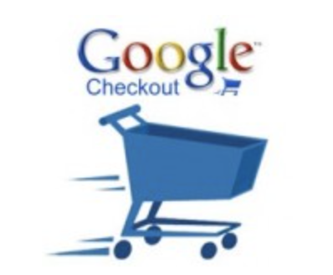
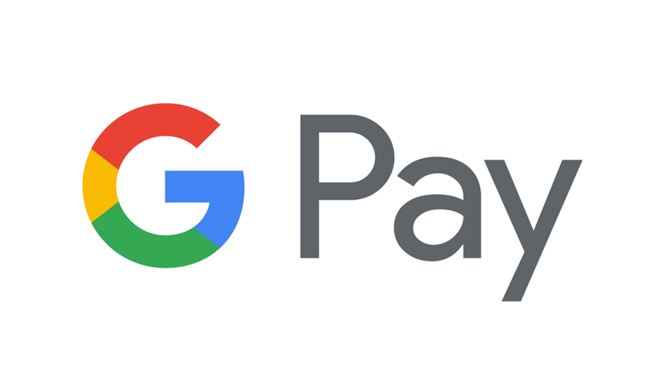
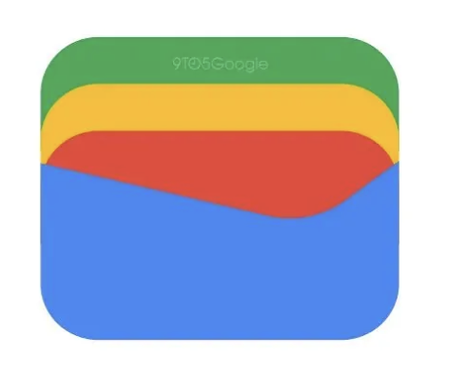
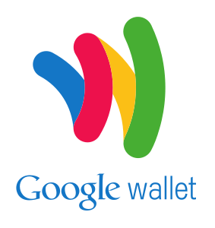
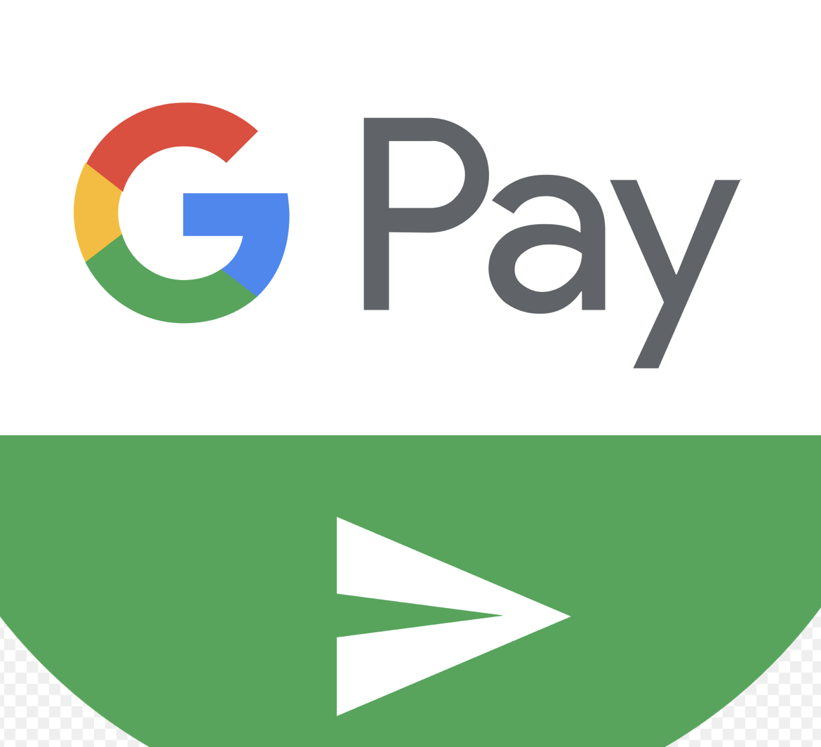
PRODUCT ROAD MAP
Google Checkout
2006
Google Pay and
Google Wallet integration
2022
Google Pay
2018
Google Wallet/
Android Pay
2016
Google Wallet/
Google Pay Send
2011
Consolidated Google Wallet and Android Pay into Google Pay.
In app, online and In-Person contactless purchase on mobile devices.
Provided new API that allows merchants to add the payment service to their websites and apps.
Integrated with Google Assistant and Google Photos
Allowed to split bills and request money from friends
Online payment processing service
Users store their card and shipping information in their Google Account
Quicker checkout
Google announced the revival of Google Wallet and integrating it with Google Pay.
New Comprehensive Digital Wallet.
Google Wallet allows users to store items such as payment cards for use via Google Pay, as well as passes such as loyalty cards, digital identification cards, digital keys, transit passes, event tickets, and health passes.
Peer to peer payment service
Initially supported only Mastercard's from Citibank.
Integration of google wallet and Gmail.
Acquired Softcard resulting in birth of Android Pay

Slide 4
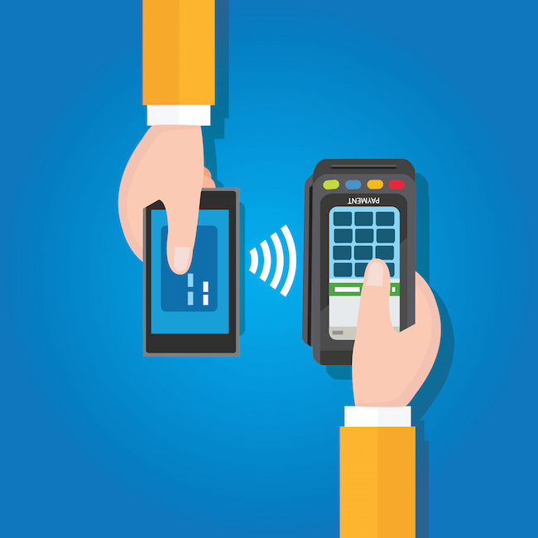



INNOVATION
Versatile and Convenient
Contactless Payment
Winner of
Innovation by Design Award (2021) in finance for streamlined interface and intuitive usability
Continuous Improvements to Security
Encryption and Tokenization
Fraud Detection using ML
Two Factor Authentication
Integration of
Services- Gmail, Photos, Maps
Rewards and Loyalty
In-app Purchases
Get Gas, Get Food

Slide 5
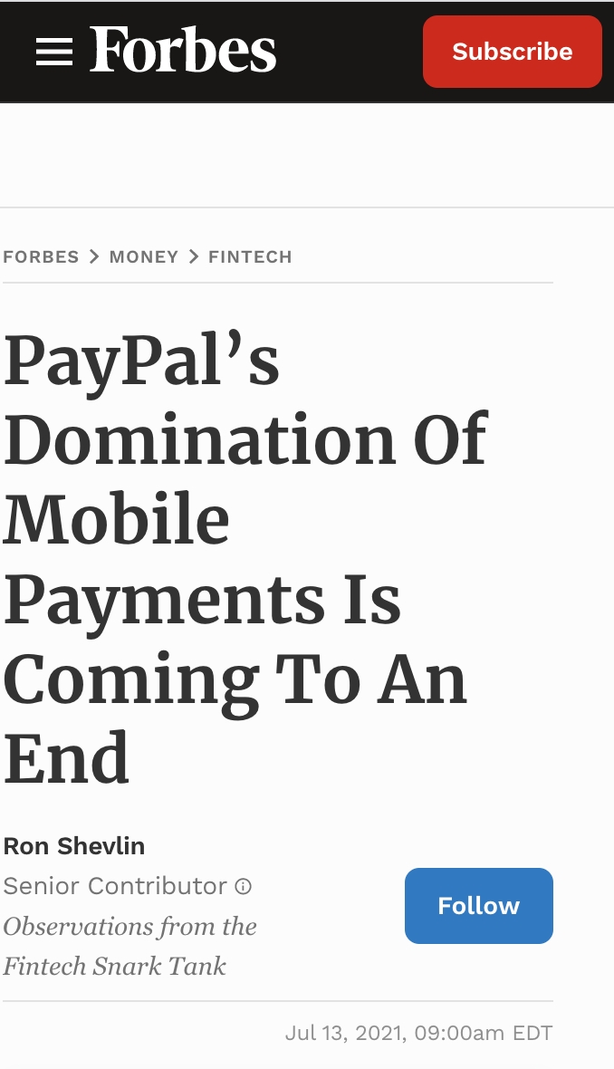
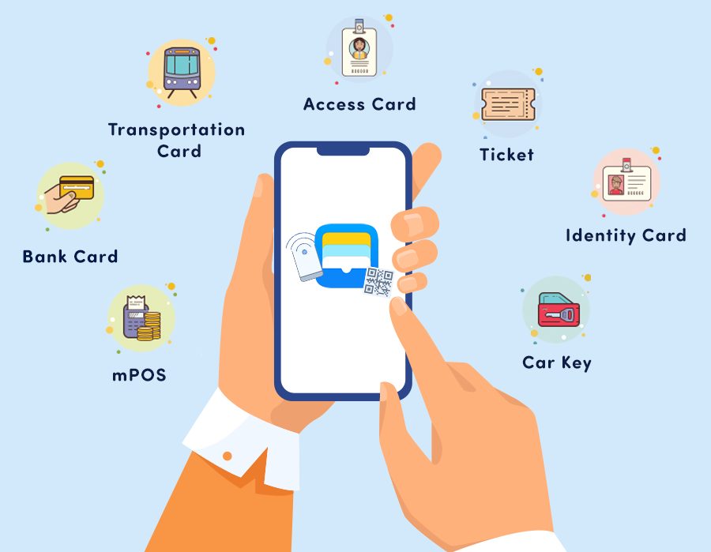
DISRUPTIVE INNOVATION
Simple and secure
contactless payments
There are certainly financial apps and services with similar offerings (think Venmo or Chase Pay for peer-to-peer payments, Honey or Rakuten for finding deals, or your bank or investment broker for analysing your spending and investments). But Google Pay offers all of these services in one place. -Josh Woodword, Director of Product Management @ Google
Encryption and Tokenization
A Comprehensive Wallet that covers
Pay
Simplicity, security and privacy, as well partnerships in financial and other service areas.
Explore
Partnered with Companies and stores to offer app-exclusive deals to users
Integration of
Services,
Rewards and Loyalty
DISRUPTIVE INNOVATION
Insight
Offers users weekly “stories” about users’ finances—
How they’re spending their money
What bills are coming up
What bank fees they were charged

Slide 6
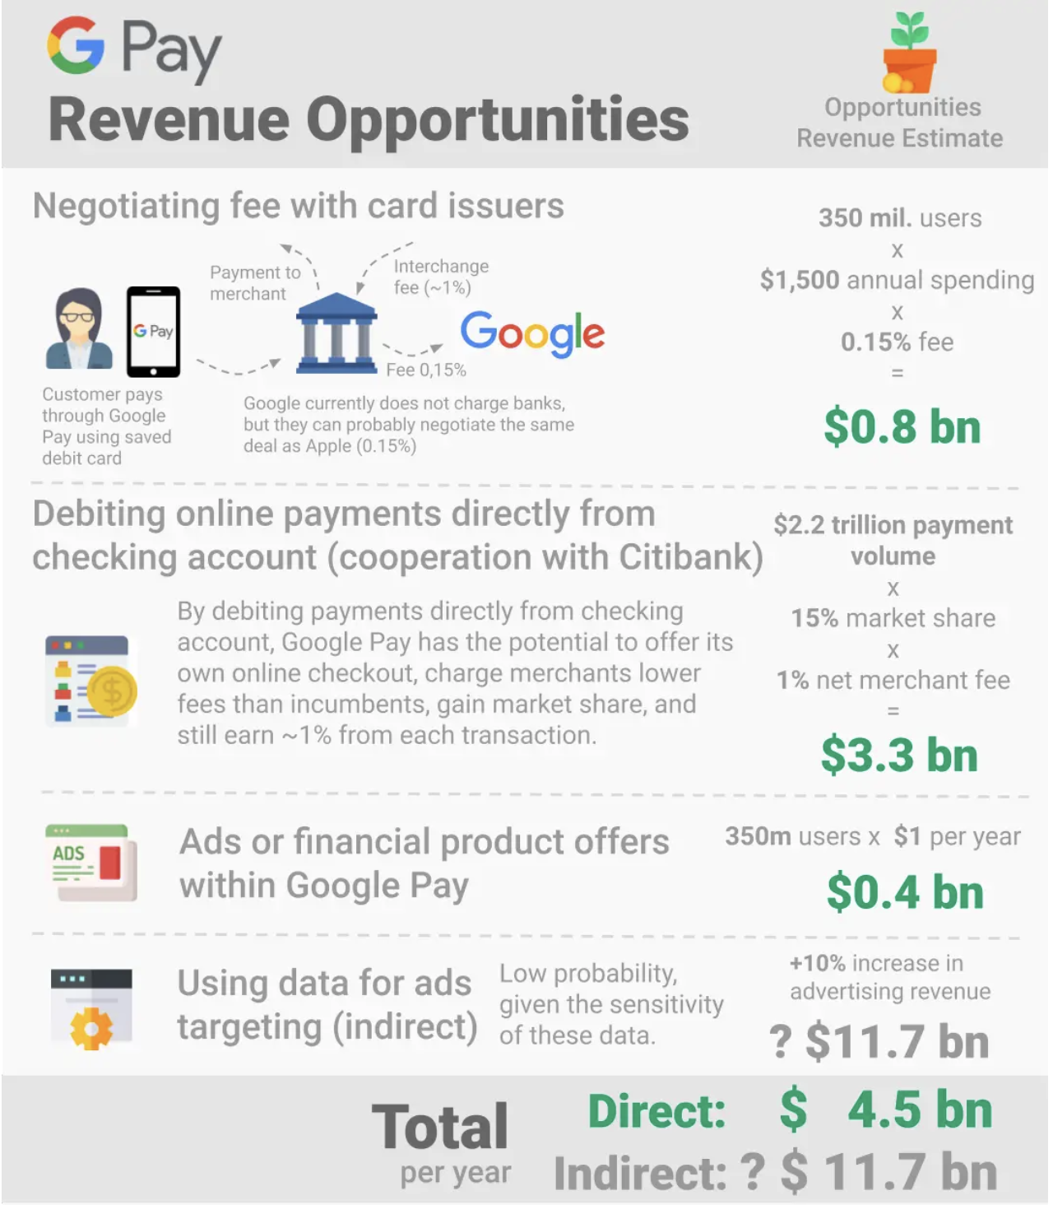
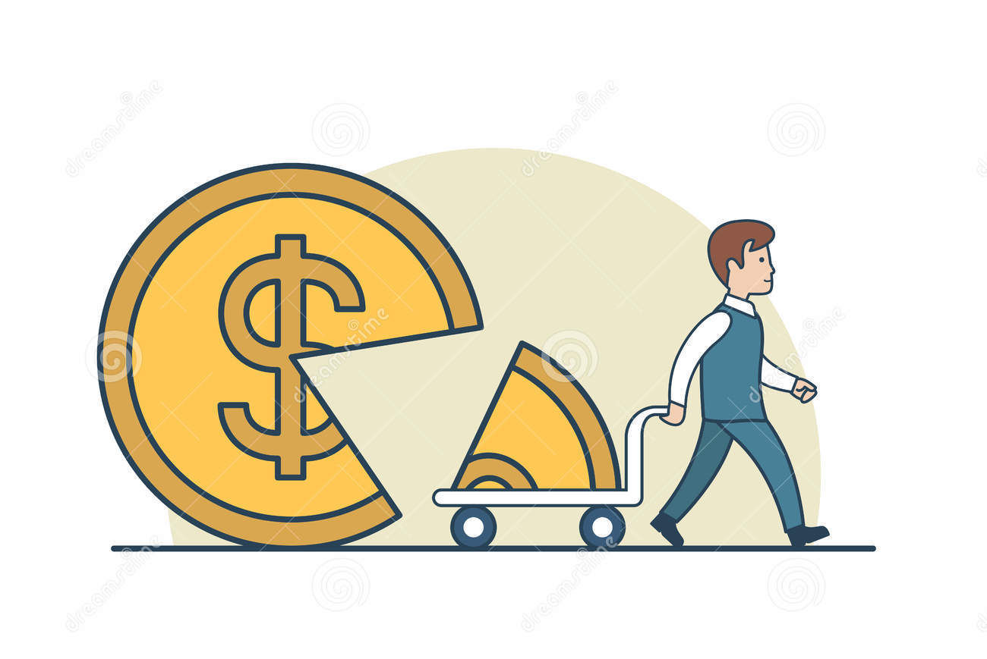

VALUE CREATION
Shareholder
Transaction Fee from Merchants
Advertising
Transaction Data
Customer
Ease of Use
Convenience
Security
Integration with Other Google Services
Business Owners- Gpay for Business
Google Pay currently does not earn any money for Google However, Google Pay has several revenue-making opportunities that can, after several years, make an estimated $4.5 billion a year.
Notes:
Ease of use: Google Pay is designed to be simple and user-friendly, allowing users to quickly and easily make payments with just a few taps on their mobile device.
Convenience: Google Pay eliminates the need to carry physical credit or debit cards, making it a more convenient way to make purchases. Users can also store loyalty cards and other types of digital cards in the app, further streamlining the payment process.
Security: Google Pay uses multiple layers of security to protect users' payment information, including encryption and two-factor authentication. This has helped to build trust among users and increase adoption.
Integration with other Google services: Google Pay is integrated with other Google services, such as Google Assistant and Google Photos, making it easy for users to access their payment information and history from within those services.
Incentives: Google Pay has offered various incentives, such as cashback rewards and discounts, to encourage users to adopt the service and make payments using the app.
Availability: Google Pay is available in a number of countries and is supported by a wide range of merchants, making it a convenient option for many people.

Slide 7
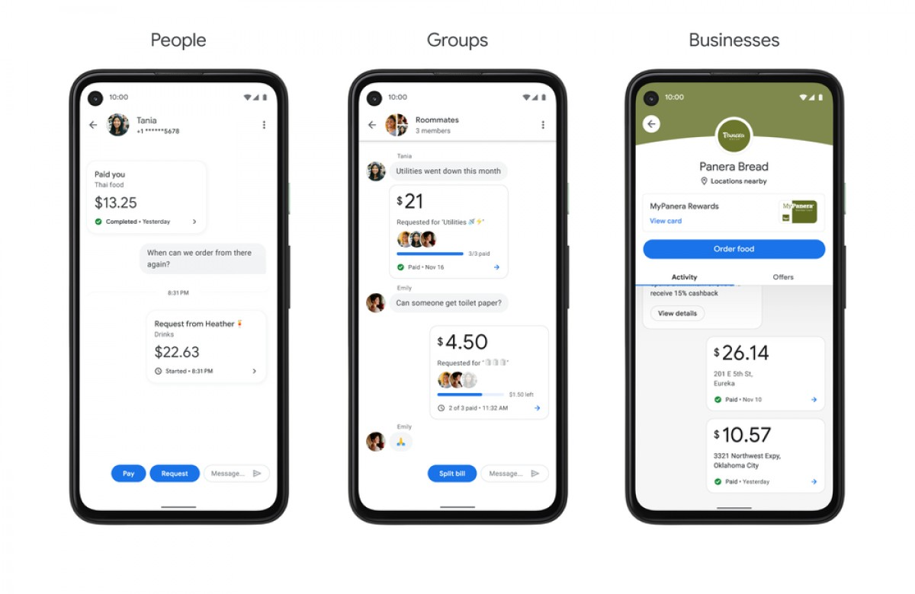

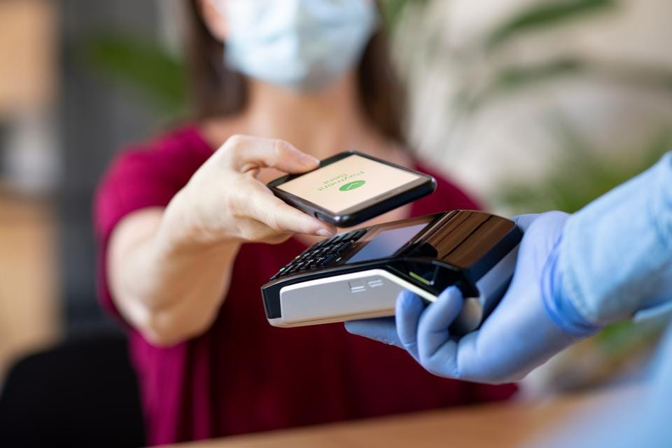

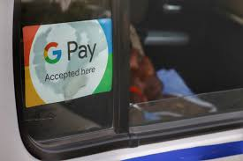
ADOPTION & STICKINESS
Google Pay focused on partnerships, localisation, and ecosystem approach as it forged deep partnerships with central bank and government to innovate and build collectively.
Google Pay has offered various incentives, such as cashback rewards and discounts, to encourage users to adopt the service and make payments using the app. It was observed that Retention tripled once people used their first scratch card.
Received $600 from Ali through GPay
Tapping into the trend… COVID 19
Google Pay is supported by a wide range of merchants because of the reduced surcharge, making it a convenient option.

Slide 8
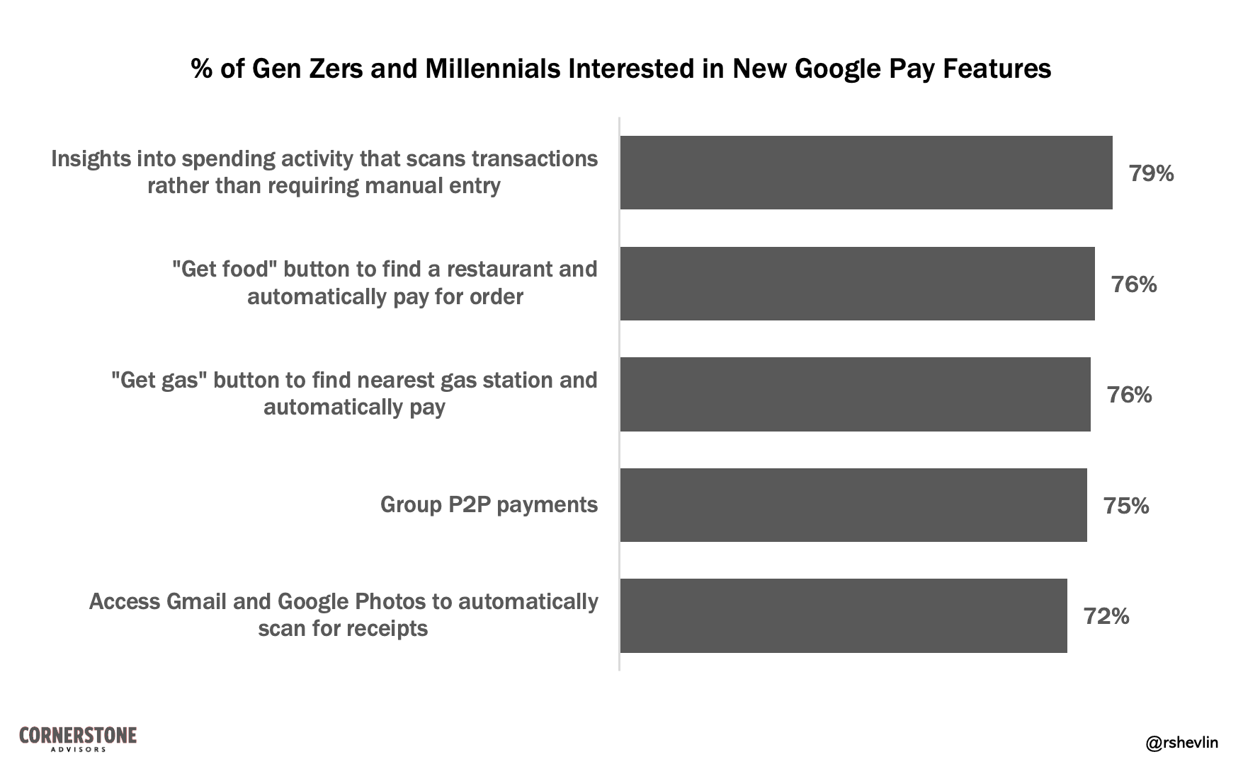
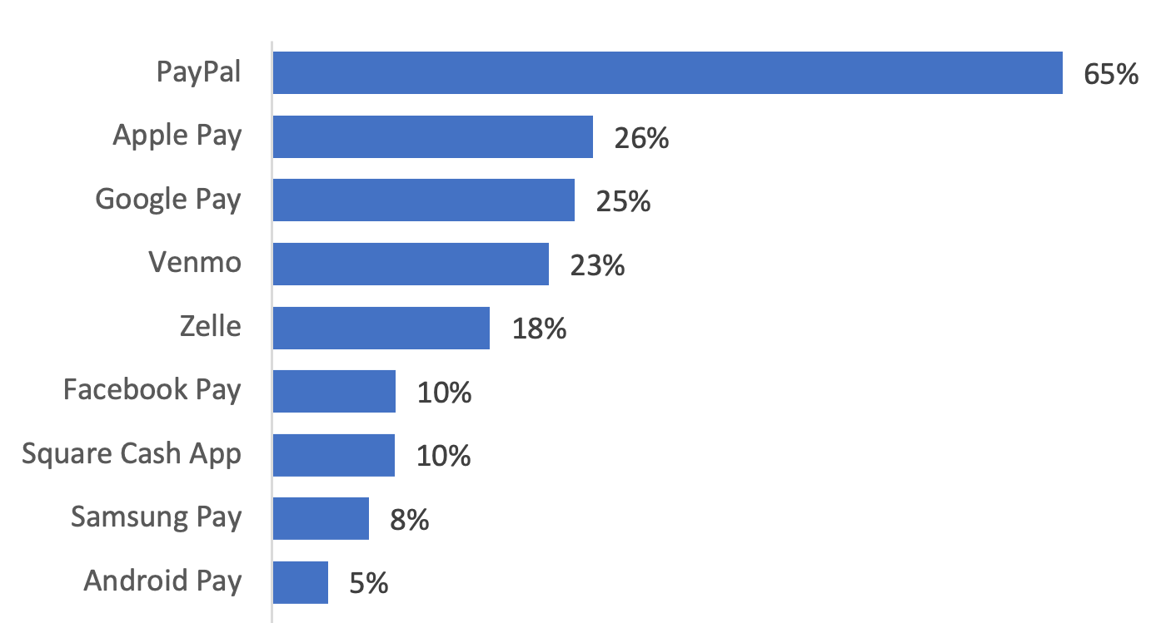
MARKETS
Simple and secure
contactless payments
Encryption and Tokenization
Adjacent
Spot on GooglePay: allowed users to discover and book appointments with local businesses.
Crypto Currencies
Job Posting Board
Integration of
Services,
Rewards and Loyalty
Market Share of Mobile Payment Apps in 2021 - Forbes
New
Online and in-store payment
Integrated Comprehensive Wallet
Gpay for Business
Existing
Peer to Peer Payments

Slide 9
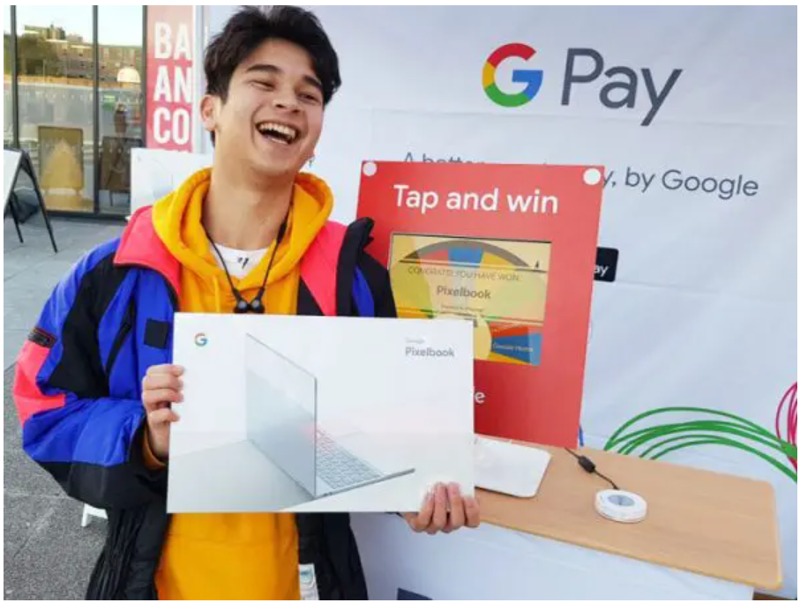
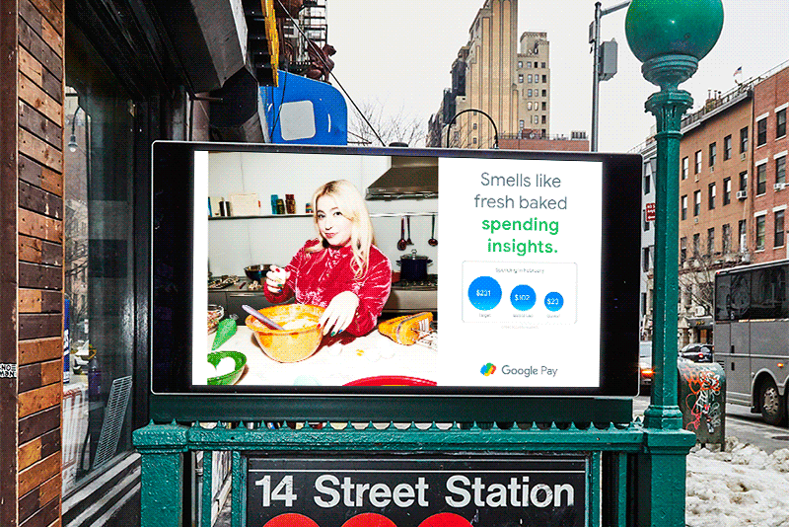

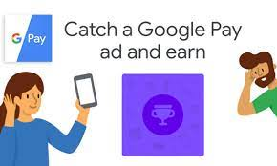
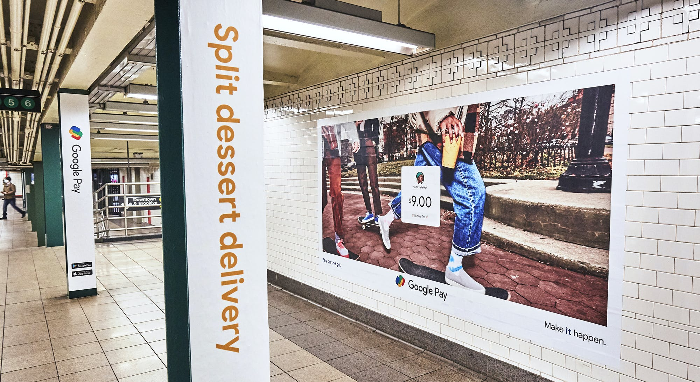
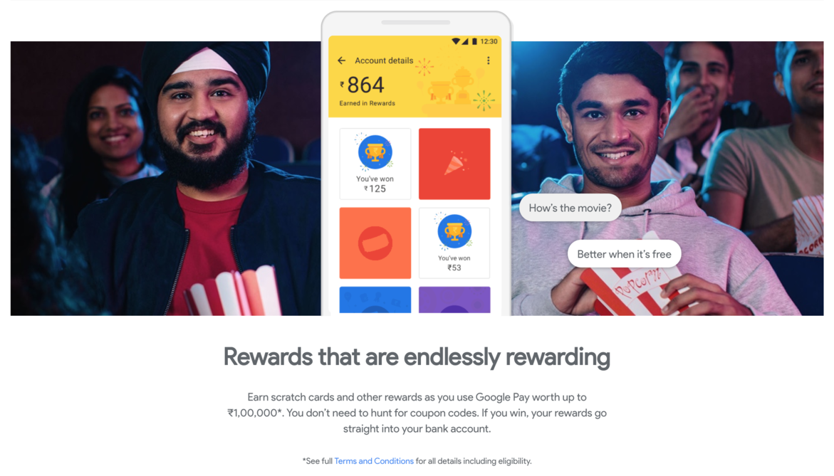
A social media, direct email, and flyering campaign further amplified buzz around university campuses, with the program reaching 59K+ students - United Kingdom
Tap & Win gamification
MARKETING STRATEGY
Cashback promises
Save money with offers and rewards
Digital marketing
Building products with interoperability
Gift or request tickets from your friends - India

Slide 10

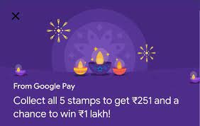
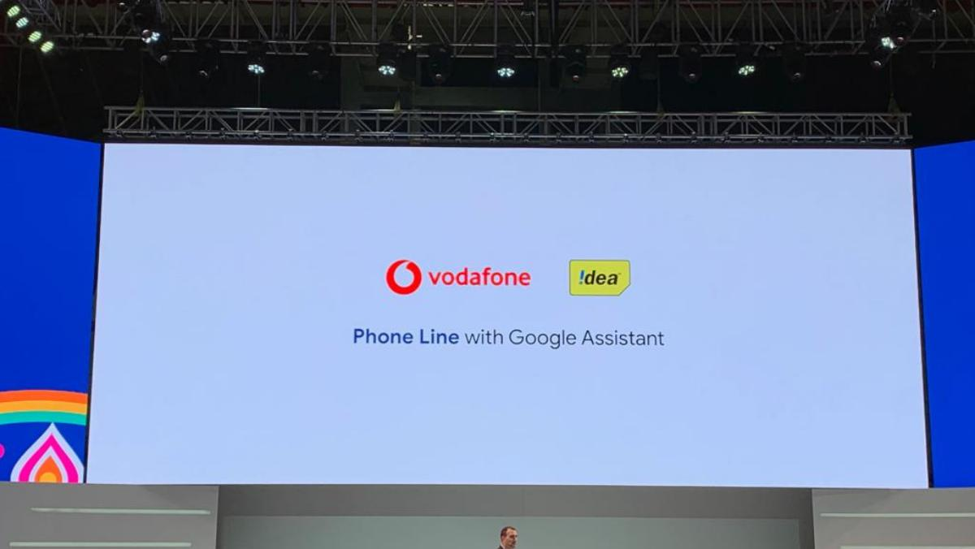
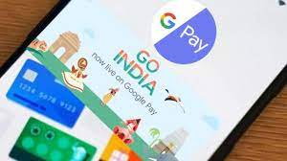
MARKETING CAMPAIGNS – INDIA
SaferWithGoogle – a safer way to pay
#GoIndia
#StampwaliDiwali
‘Digital Payment Abhiyan’ – increasing awareness about cashless payment and online financial security in the country.
‘The Vodafone-Idea Phone Line’ – to help people in the rural areas, where internet connection is weak, get information about everything.

Slide 11
SWOT ANALYSIS
Strengths | Weaknesses
Streamlined interface and intuitive usability. Integration with other Google Services. Payment Insights. Rewards, cashback and loyalty programs. | Geographic availability. Emotional acceptance. It does not support all cards, Ex: RuPay. Monetization challenge.
Opportunities | Threats
Increase geographic availability. Enhance security and privacy – when compared to its competition. Redesign its rewards and loyalty program. Integrate with more merchants and services. Increase user engagement – by offering personalised recommendations. | Security breaches. Advancements by its competition. Regulatory issues. Payment habits.

Slide 12
Thank You

Slide 13
References
Dutta, Purbalee. “Google Pay Success Story: Promoting Cashless Transactions.” StartupTalky, StartupTalky, 23 Dec. 2021, https://startuptalky.com/google-pay-success-story/
“Google Wallet.” Wikipedia, Wikimedia Foundation, 27 Dec. 2022, https://en.wikipedia.org/wiki/Google_Wallet
Baxi, Abhishek. “Google Pay Is Evolving into a Platform to Grab a Slice of India's Growing Digital Economy.” Forbes, Forbes Magazine, 26 Sept. 2019, https://www.forbes.com/sites/baxiabhishek/2019/09/25/google-pay-is-evolving-into-a-platform-to-grab-a-slice-of-indias-growing-digital-economy/?sh=3cca03794868%E2%80%8B
https://www.alternativepayments.com/product-sheets/AP_PS_Alipay_v2.pdf
“Google Pay (Payment Method).” Wikipedia, Wikimedia Foundation, 2 Dec. 2022, https://en.wikipedia.org/wiki/Google_Pay_(payment_method)
“What is Google Pay” Credit Karma, https://www.creditkarma.com/money/i/what-is-google-pay%E2%80%8B
A comprehensive google pay case https://streamlynacademy.com/blog/a-comprehensive-google-pay-case-study/
How Google Pay was designed to be the only financial app you need, https://www.fastcompany.com/90667005/google-pay-app-innovation-by-design-2021

Slide 14
References
Ten things Google Pay did to become the top payment app in India, https://bfsi.economictimes.indiatimes.com/news/fintech/ten-things-google-pay-did-to-become-the-top-payment-app-in-india/73962698
Google is getting into banking to take back the business it lost to Amazon, https://www.cnbc.com/2019/11/13/google-is-getting-into-banking-to-take-back-the-business-it-lost-to-amazon.html
Google Pay rolls out the next evolution in mobile money management, https://www.mastercard.com/news/perspectives/2020/google-pay-rolls-out-the-next-evolution-in-mobile-money-management/
Google sets out its vision for the future of Google Pay, https://www.nfcw.com/whats-new-in-payments/google-sets-out-its-vision-for-the-future-of-google-pay/
Google launches redesigned Google Pay app with focus on financial management, https://www.zdnet.com/finance/google-launches-redesigned-google-pay-app-with-focus-on-financial-management/
The Problem With Google Pay, https://www.forbes.com/sites/ronshevlin/2022/01/25/the-problem-with-google-pay/?sh=258455283a50
PayPal’s Domination Of Mobile Payments Is Coming To An End, https://www.forbes.com/sites/ronshevlin/2021/07/13/paypals-domination-of-mobile-payments-is-coming-to-an-end/?sh=767a4bd42e6d

